Slide 1
RNN & Neural Network Debug COMP4423 Computer Vision
Xiaoyong Wei (魏驍勇)
x1wei@polyu.edu.hk

Slide 2
Debug - Data
Data shape
PyTorch: NCHW for convolution
Tensorflow: NHWC for convolution
OpenCV: HWC for data, but XY for parameters
Data type
Typically, we use float (float32)
Half precision (float16) are often used for acceleration
Images are generally stored in uint8, so conversion should be considered
Visualization (tensorboard)

Slide 3
Debug – Model & Loss
Model
Trainable parameters
Initialization method
Model capacity/design vs Purpose
Loss
Proper loss function following previous experience
Correct parameters (e.g., sum vs mean)
Balance between different loss functions

Slide 4
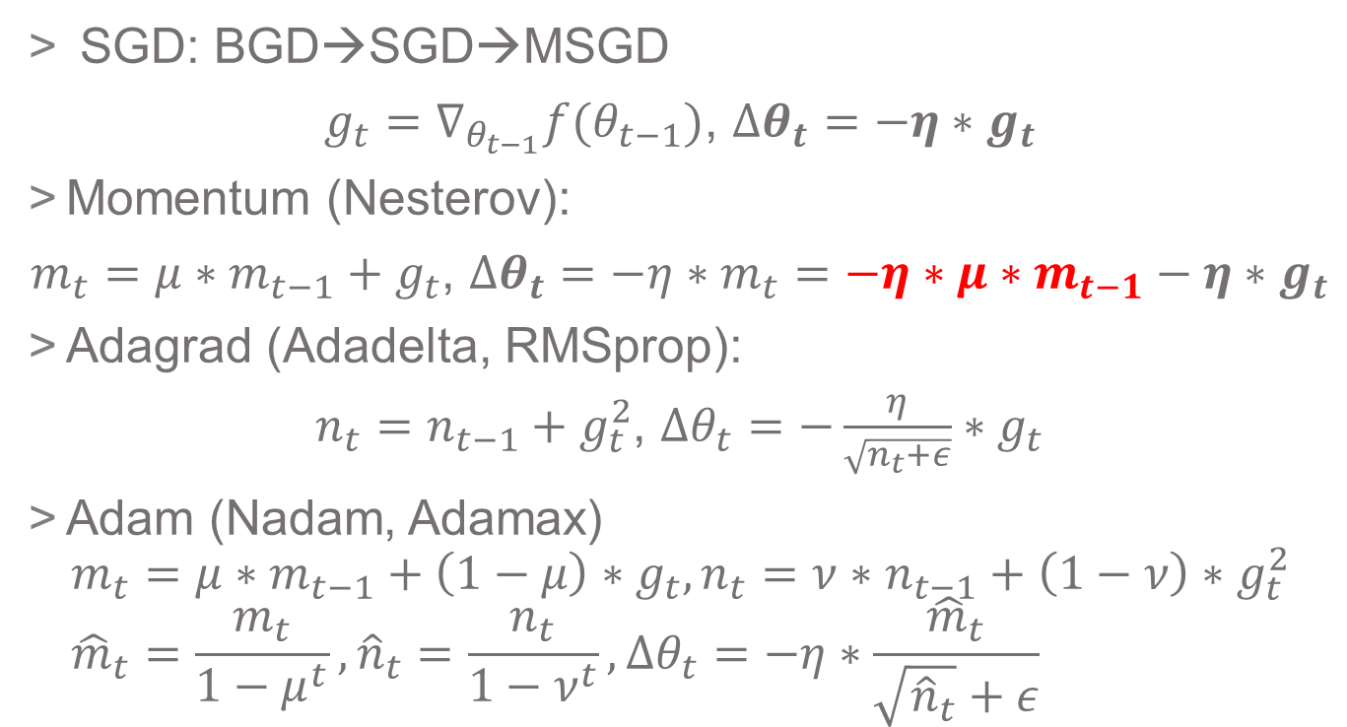
Debug – Optimizer
SGD: BGD→SGD→MSGD
$g_{t}=∇_{θ_{t−1}}f(θ_{t−1})$, $∆θ_{t}=−η∗g_{t}$
Momentum (Nesterov):
$m_{t}=μ∗m_{t−1}+g_{t}$, $∆θ_{t}=−η∗m_{t}=−η∗μ∗m_{t−1}−η∗g_{t}$
Adagrad (Adadelta, RMSprop):
$n_{t}=n_{t−1}+g_{t}^{2}$, $∆θ_{t}=−\frac{η}{\sqrt{n_{t}+ε}}∗g_{t}$
Adam (Nadam, Adamax)
$$m_{t}=μ∗m_{t−1}+\left(1−μ\right)∗g_{t}, n_{t}=ν∗n_{t−1}+\left(1−ν\right)∗g_{t}^{2} \\ {\hat{m}}_{t}=\frac{m_{t}}{1−μ^{t}},{\hat{n}}_{t}=\frac{n_{t}}{1−ν^{t}},∆θ_{t}=−η∗\frac{{\hat{m}}_{t}}{\sqrt{{\hat{n}}_{t}}+ε}$$

Slide 5
Debug – Optimizer

Slide 6
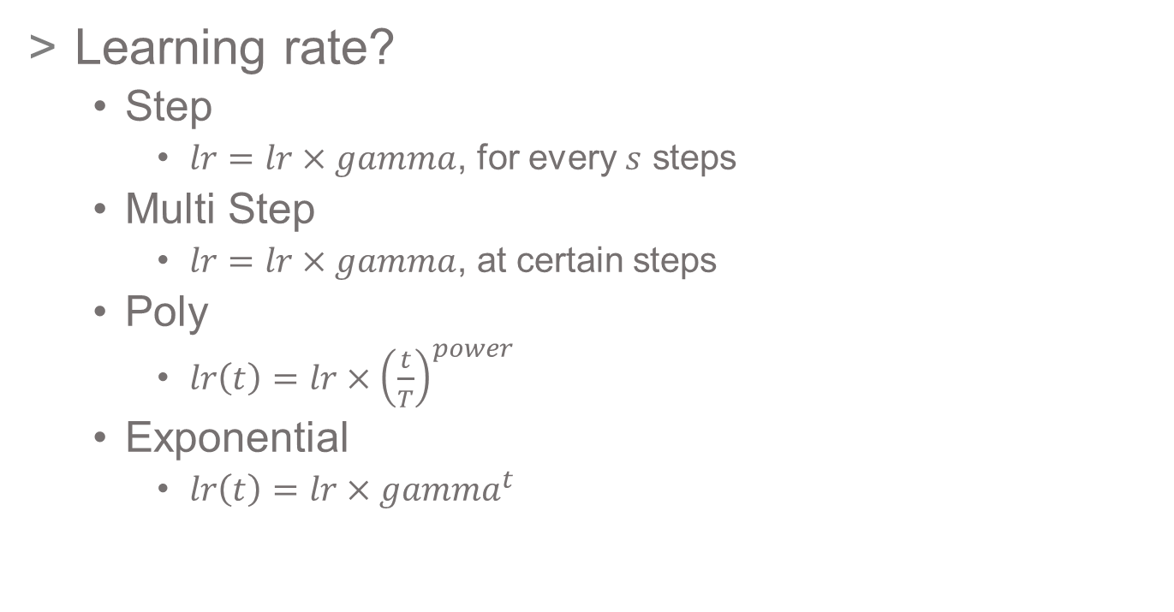
Debug – Learning Rate
Learning rate?
Step
$lr=lr×gamma$, for every $s$ steps
Multi Step
$lr=lr×gamma$, at certain steps
Poly
$lr\left(t\right)=lr×{\left(\frac{t}{T}\right)}^{power}$
Exponential
$lr\left(t\right)=lr×gamma^{t}$

Slide 7
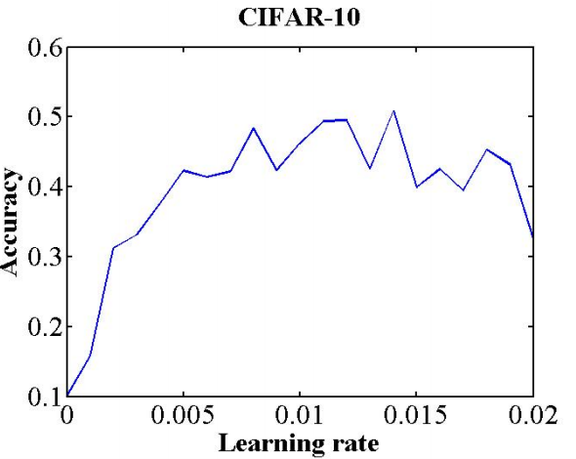
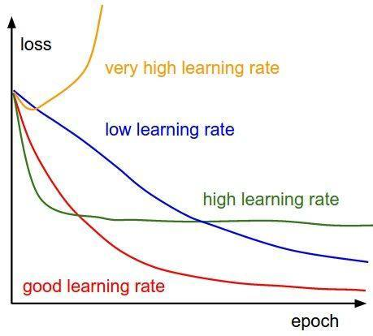
Debug – Learning Rate
Learning rate?

Slide 8
Debug – Other Skills
LR policy (e.g., warm up, early stop)
Data augmentation
Label smoothing
Regularization
Normalization
…

Slide 9
Debug – Torchgrad vs Torchnograd
TorchGrad：
contains all the functionality related to autograd auto-differentiation, where PyTorch's auto-differentiation engine resides.
It includes differentiation functions for Tensors (such as .backward() ) and many utility functions that build neural network layers, loss functions, and various other components that can be used to train machine learning models.
Torchnograd：
is a collection of Tensor operations without autograd functions. It contains most operations of Tensor, but does not contain any differential functions.
If you want to use PyTorch for scientific computing tasks that do not involve training machine learning models, Torchnograd will be more suitable

Slide 10
Debug – Torchgrad vs Torchnograd
TorchGrad：
# model construction
net = Net()
criterion = nn.CrossEntropyLoss()
optimizer = optim.SGD(net.parameters(), lr=0.001, momentum=0.9)
# zero the parameter gradients
optimizer.zero_grad()
# forward + backward + optimize
outputs = net(inputs)
loss = criterion(outputs, labels)
loss.backward()
optimizer.step()
Torchnograd：
# initialize tensor
tensor = torch.rand(3, 4)
print(tensor)
#slice and index
print(tensor[:, 1])
print(tensor[0, :])
print(tensor[1, 1:3])
# matrix multiplication
mat1 = torch.rand(2, 3)
mat2 = torch.rand(3, 1)
print(torch.mm(mat1, mat2))

Slide 11
Thank you!

